Slide 1
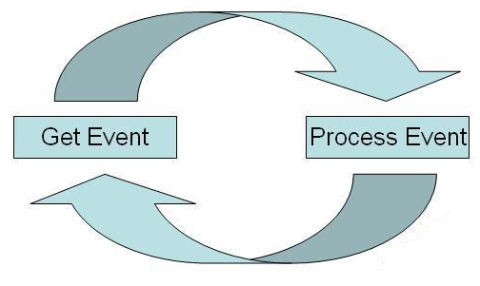
event-driven programming
In computer programming, event-driven programming is a programming paradigm in which the flow of the program is determined by events such as user actions (mouse clicks, key presses), sensor outputs, or messages from other programs/threads.

Slide 2
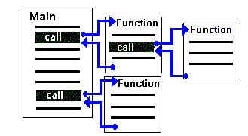
Procedural programming
Any given procedure might be called
at any point during a program's
execution, including by other
procedures or itself.

Slide 3
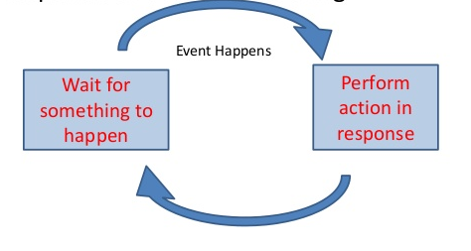
Event-driven programming
Program waits for events
Whenever something happens the program responds and does something

Slide 4
Event-driven programming
Standard approach for GUIs
Contrast with old character interface – program determines what happens
In GUI, the user triggers what application does (mostly)
Event examples are key press, mouse move, mouse click (button/link), timer (timeouts)
Correspond to native Windows Messages (next slide)
Event handler = subroutine which will execute when that event happens

Slide 5
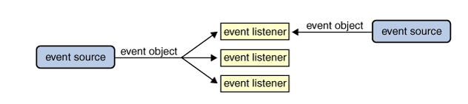
Event Listeners
Any number of event listener objects can listen for all kinds of events from any number of event source objects. For example, a program might create one listener per event source. Or a program might have a single listener for all events from all sources. A program can even have more than one listener for a single kind of event from a single event source.
Multiple listeners can register to be notified of events of a particular type from a particular source.
Also, the same listener can listen to notifications from different objects.
Each event is represented by an object that gives information about the event and identifies the event source.
Event sources are often components or models, but other kinds of objects can also be event sources.

Slide 6
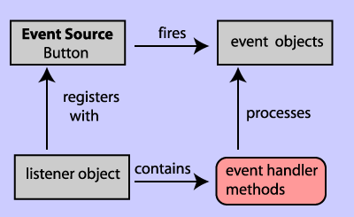
Event-driven Architecture

Slide 7
Event Handling Methods
An event may:
Trigger a response, or
Move objects into positions that create some condition (e.g. a collision) that trigger a response.
A method is called to carry out the response. We call this kind of method an event handling method
When a event is linked to a method that performs an action, behavior is created

